Slide 1
13 years of Aerosol measurements with PFR and CIMEL sun-photometers at Davos: Aerosol optical depth and trend analysis comparison
Angelos Karanikolas^{1,2}, Natalia Kouremeti¹, Julian Gröbner¹, Luca Egli¹ and Stelios Kazadzis¹
¹Physikalisch-Meteorologisches Observatorium Davos, World Radiation Center (PMOD/WRC), Davos Dorf, Switzerland
²ETH Zurich-Institute for Particle Physics and Astrophysics, Hönggerberg campus, Stefano-Franscini-Platz 5, 8093 Zurich, Switzerland

Slide 2
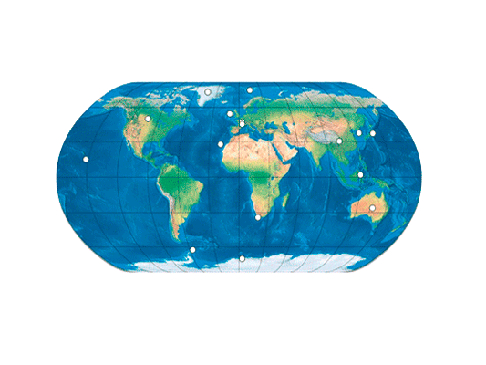
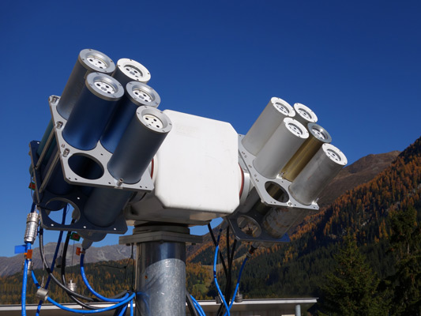
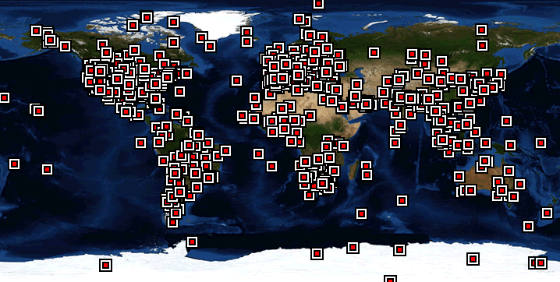
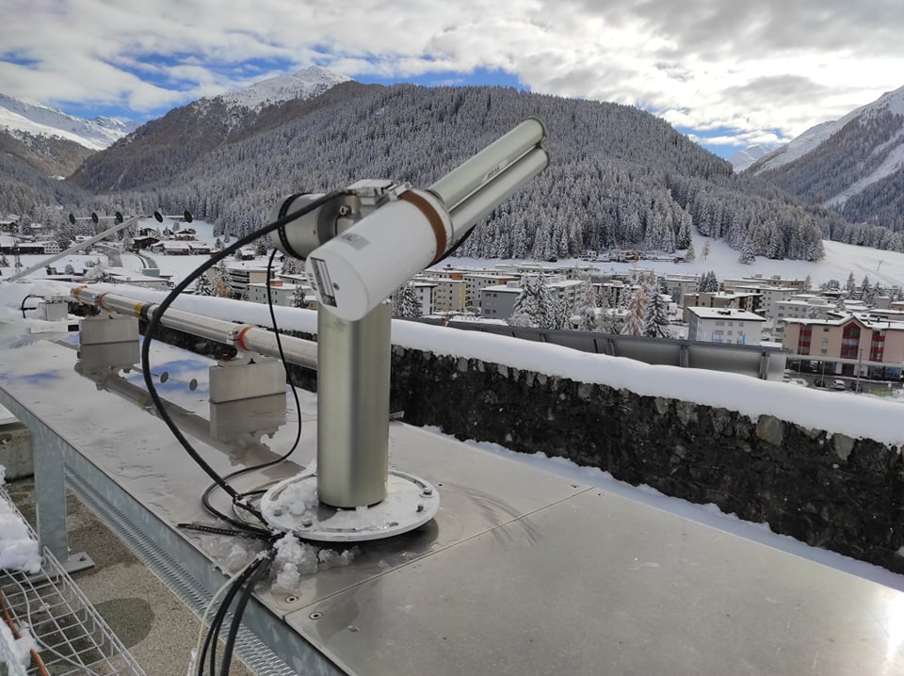
Introduction
GAW-PFR: Precision Filter Radiometers (PFRs). Direct sun observations in 4 channels: 368, 412, 501 and 862 nm
AERONET: CIMEL Sun Photometers. Direct and sky observations in 7 channels: 340, 380, 440, 500, 675, 870 and 1020 nm
500-501 nm and 862-870 nm are directly comparable
PMOD/WRC: CIMEL and PFRN27 operated in parallel for 2005-present.
Differences:
  Technical characteristics
  Calibration procedures
  Post processing algorithms
  Cloud screening algorithms
  Measurement frequencies

Slide 3
Scientific questions
How well synchronous measurements of the two instruments agree?
How well GAW-PFR and AERONET cloud screening algorithms agree?
How AOD trends based on instruments with different measurement frequencies agree?
What is the effect of the measurement uncertainty on the trend analysis?

Slide 4
Cloud screening comparison
All data | 2007-2019 | AOD mean
Dataset | N | 500 nm | 865 nm
CIMEL level 1 | 69259 | 0.155 | 0.128
PFRN27 level 3 all values | 1009690 | 0.153 | 0.122
CIMEL level 2 | 44824 | 0.069 | 0.034
PFRN27 level 3 clear sky | 392439 | 0.061 | 0.029
Synchronous data | N | CIMEL 500 | PFRN27 501 | CIMEL 870 | PFRN27 862
PFRN27 level3 all values with CIMEL level 1 | 54683 | 0.1 | 0.098 | 0.071 | 0.066
PFRN27 level3 all values with CIMEL level 2 | 41373 | 0.065 | 0.067 | 0.032 | 0.032
PFRN27 level3 clear sky with CIMEL level 1 | 25422 | 0.058 | 0.058 | 0.030 | 0.028
PFRN27 level3 clear sky with CIMEL level 2 | 23155 | 0.055 | 0.056 | 0.0261 | 0.026
7.7% of CIMEL level 2 data do not have synchronous measurements with PFR level 3 data
44% of CIMEL level 2 data synchronized with PFRN27 level 3 are not cloud free according to PFR algorithm
8.9% of CIMEL level 1 data synchronized with PFRN27 level 3, on cloud free conditions according to PFRN27, are not present in the level 2 data
The average AOD differences between PFRN27 and CIMEL data are smaller than the measurement uncertainty (0.01) for either cloud filtered and unfiltered data.

Slide 5
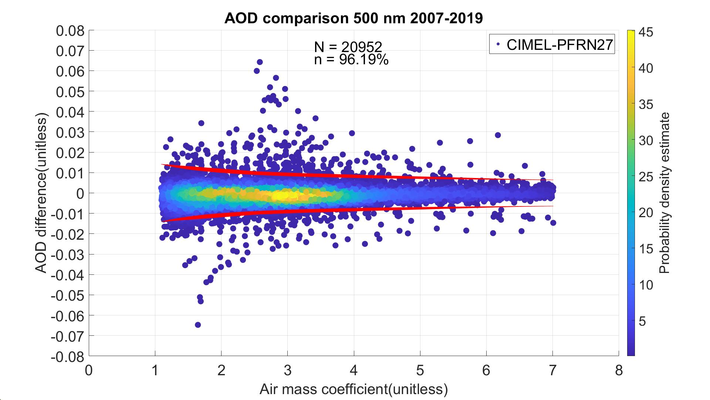
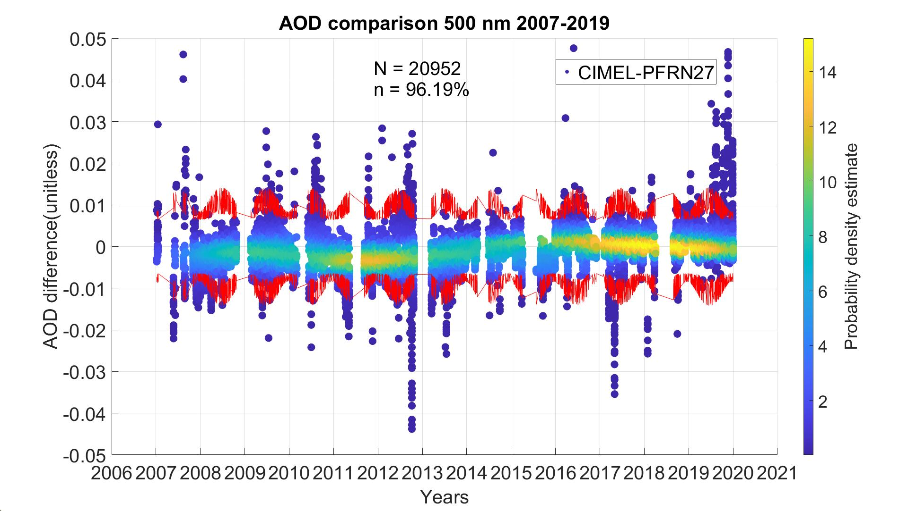
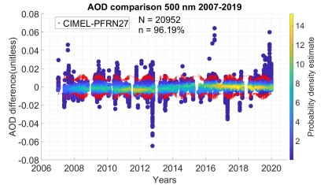
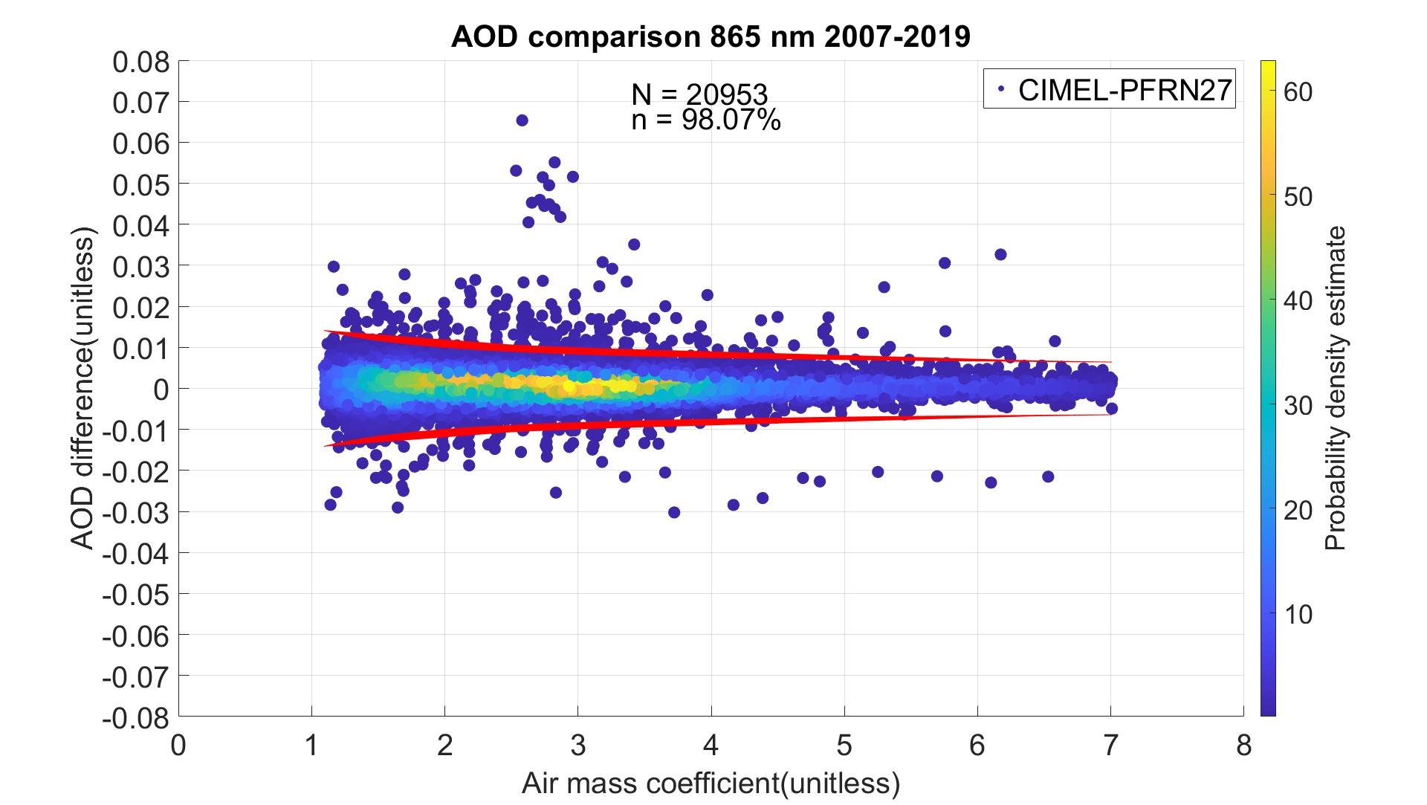
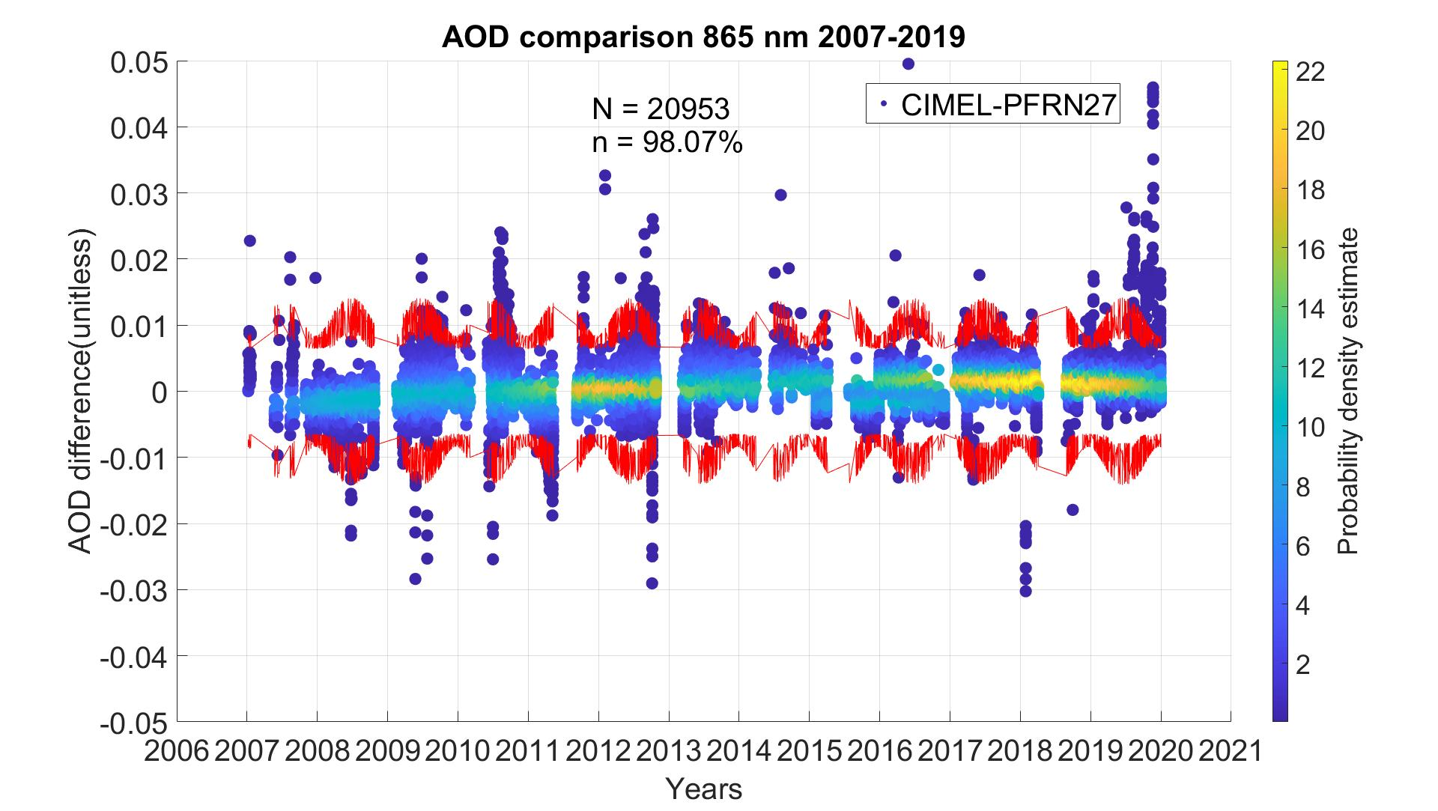
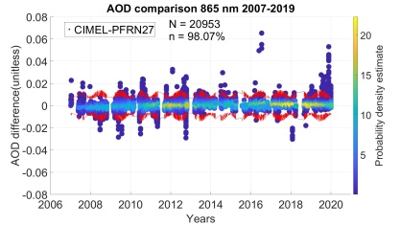
CIMEL-PFRN27 AOD comparison
  AOD comparison according to WMO criteria:
    at least 1000 data points with AOD at 500 nm between 0.04 and 0.20
    a minimum duration of 5 days
    At least 95% of measurements within AOD difference ±0.005±0.01/m (m: air mass) [WMO,2005]

Slide 6
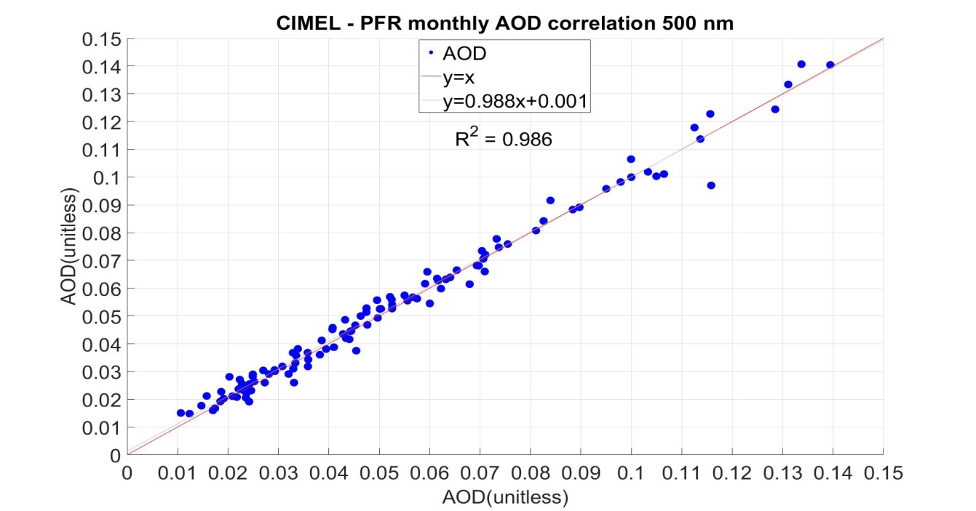
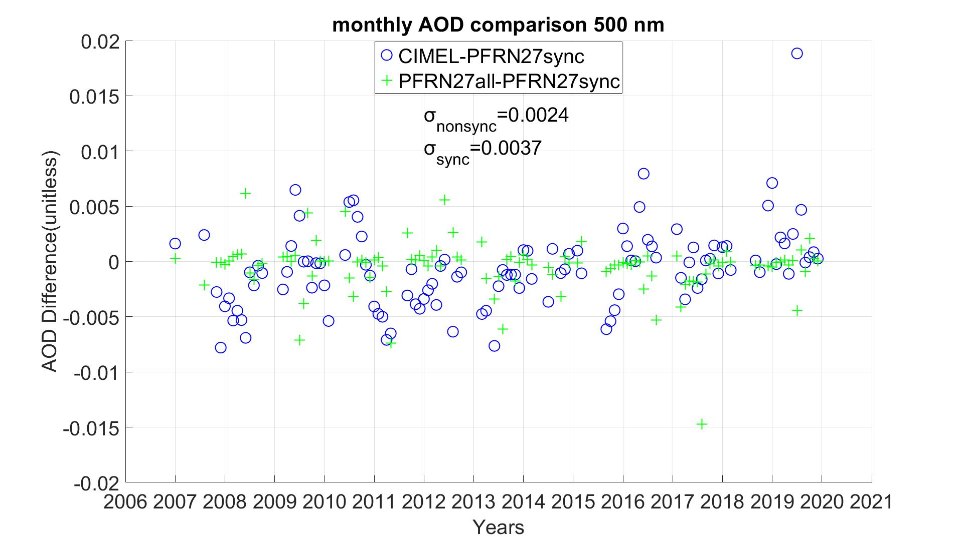
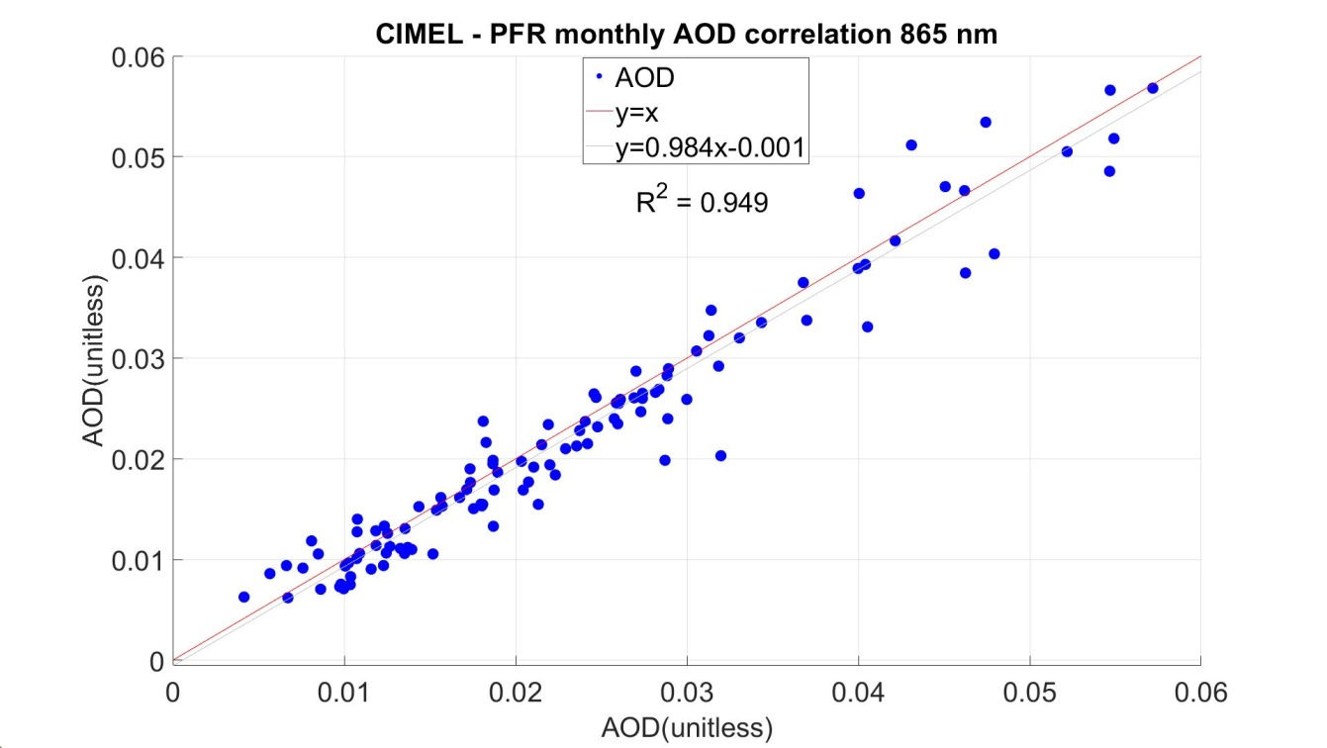
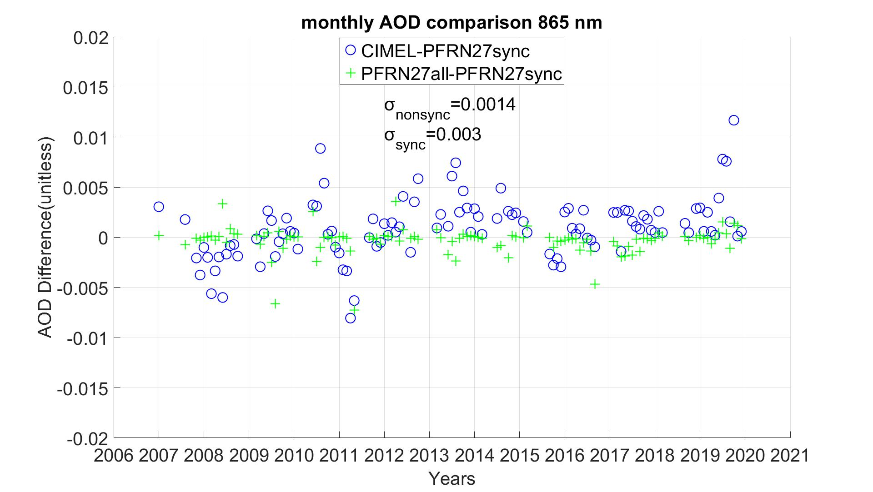
Monthly AOD data comparison
±0.01 measurement
uncertainty

Slide 7
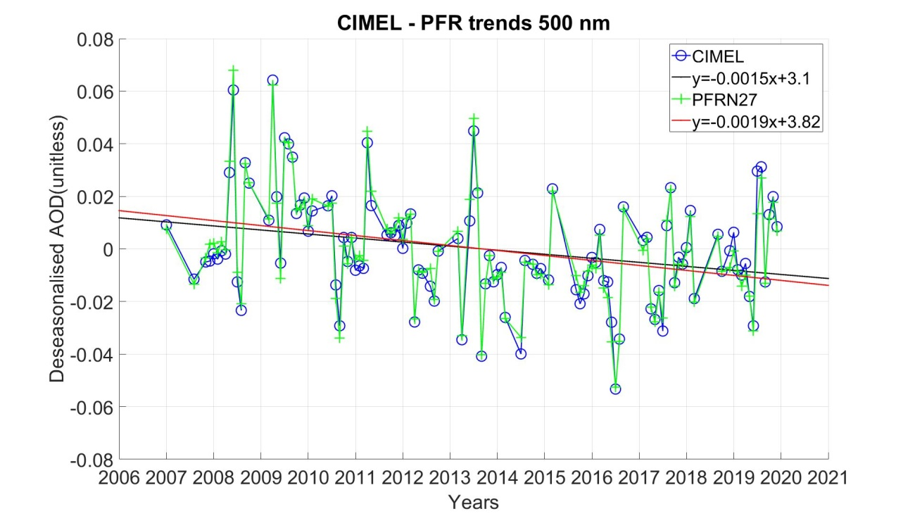
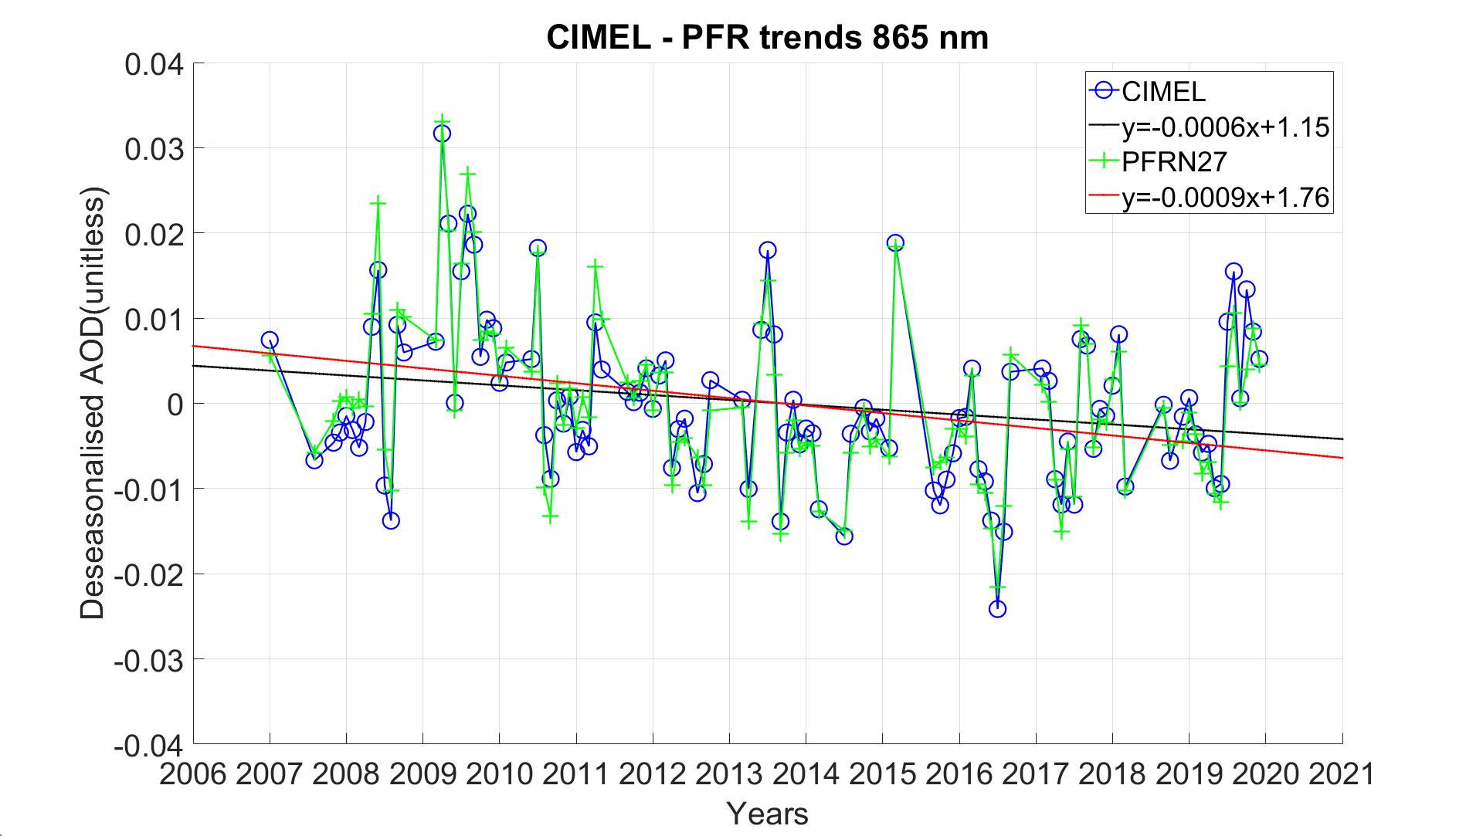
Linear trend comparison: Synchronous
Linear trends: Least square linear regression (LSLR)
Statistical significance: Modified Mann-Kendall test [Hamed & Rao 1998]
Measurement uncertainty (σ_{m}) effect on trend analysis: Monte Carlo method
σ_{m}=0.01 [Holben et al. 1998, Kazadzis et al. 2018a]
Timeseries | Trend per decade (*10⁻³) | Standard error (*10⁻³) | p-value observed (*10⁻³) | Random trend st.d. (*10⁻³)
CIMEL 500 nm | -15.4 | 5.05 | 9.51 | 1.45
PFRN27 501 nm | -19.0 | 5.00 | 0.49 | 1.50
CIMEL 870 nm | -5.7 | 2.29 | 25.30 | 1.47
PFRN27 862 nm | -8.8 | 2.27 | 0.45 | 1.53

Slide 8
Linear trend comparison: Non-synchronous
Timeseries | Trend per decade (*10⁻³) | Standard error (*10⁻³) | p-value observed (*10⁻³) | Random trend st.d. (*10⁻³)
PFRN27 501 nm synchronous | -18.95 | 5.00 | 0.49 | 1.50
PFRN27 501 nm non-sychronous | -19.93 | 4.99 | 1.34 | 1.51
PFRN27 862 nm synchronous | -8.76 | 2.27 | 0.45 | 1.53
PFRN27 862 nm non-sychronous | -7.65 | 2.25 | 0.174 | 1.45

Slide 9
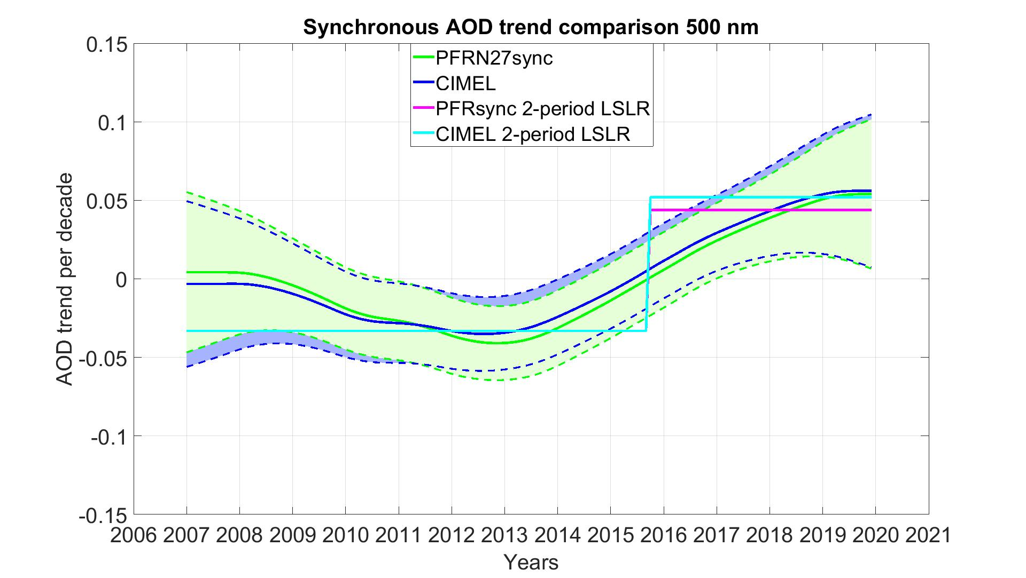
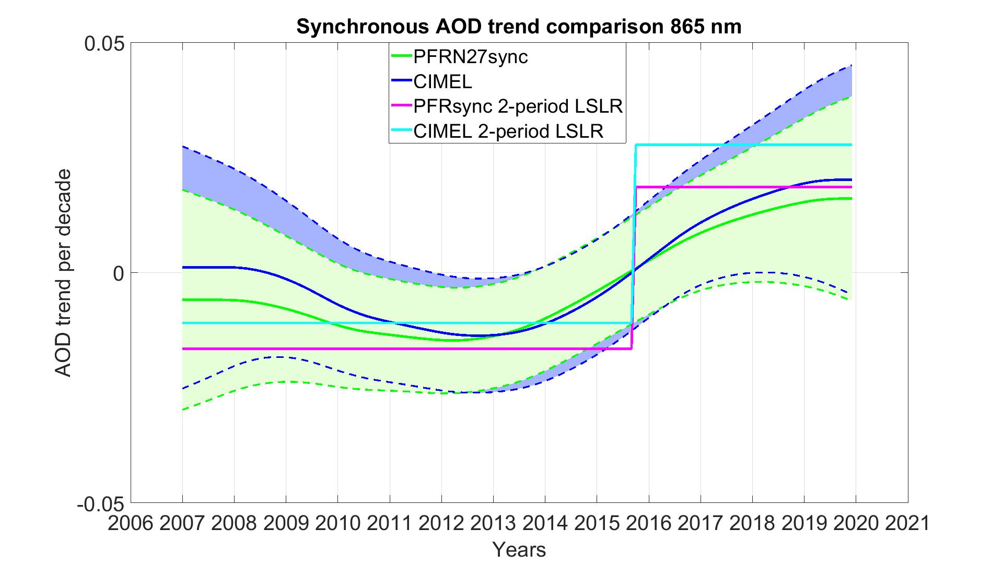
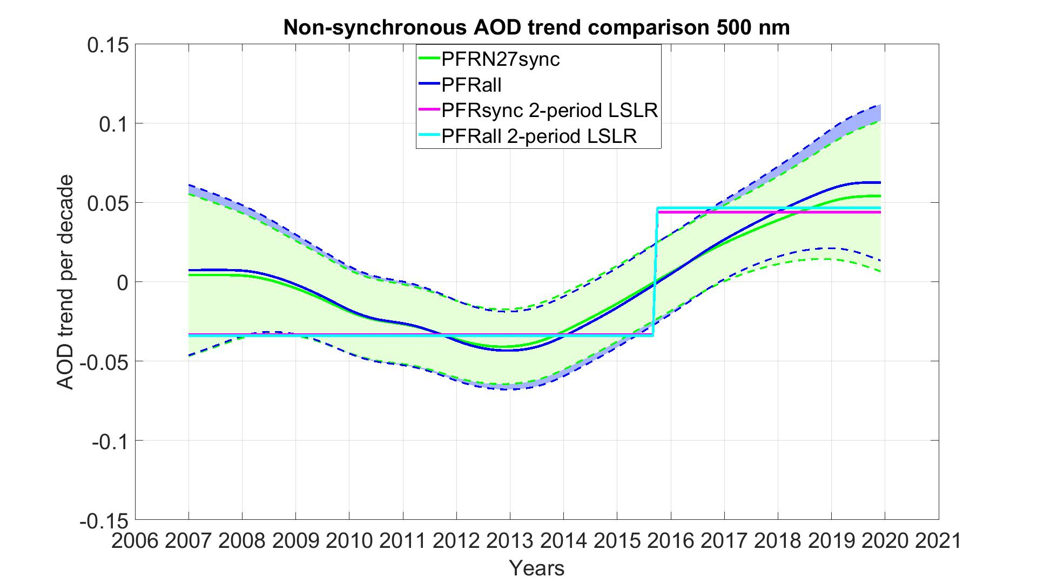
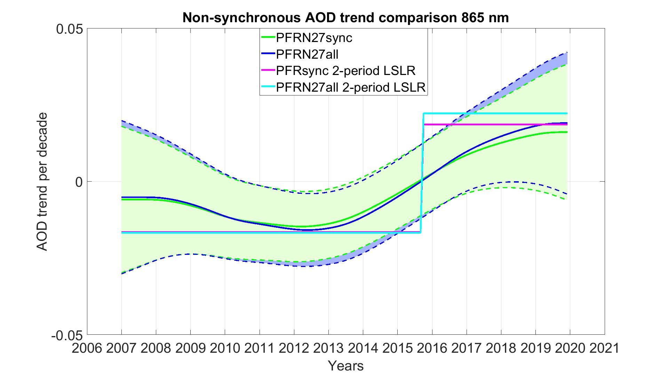

Time dependent trend comparison
Method: Dynamic Linear Modeling (DLM) [Laine et. al 2014]
Input monthly median uncertainty:
$s=\sqrt{{0.01}^{2}+{(P_{75th}−P_{25th})}^{2}}$
Seasonal components: annual cycle

Slide 10
Conclusions
The instruments comply with the WMO criteria and correlate well.
A closer look on the thin cirrus cloud identification from AERONET and GAW-PFR algorithms is needed.
The measurement frequency has minimal effect on the long-term trends for both methods, which is smaller than the effect of measurement uncertainty.
The largest trend differences appear in the comparison of different instruments regardless the datasets are synchronous or not. They are larger than the effect of measurement uncertainty.
The better compliance with WMO limits in 862-870 nm does not lead to better trend agreement. This is explainable by the fact that the limits are the same for both channels, but the AOD values higher at 500 nm.
The time dependent trends display a better agreement and are not monotonic. LSLR for 2 separate periods is a good approximation.

Slide 11
References
Cuevas, E., Romero-Campos, P. M., Kouremeti, N., Kazadzis, S., Räisänen, P., García, R. D., ... & Almansa, F. (2019). Aerosol optical depth comparison between GAW-PFR and AERONET-Cimel radiometers from long-term (2005–2015) 1 min synchronous measurements. Atmospheric Measurement Techniques, 12(8), 4309-4337.
Gregory, L. (2011). Cimel Sunphotometer (CSPHOT) Handbook (No. DOE/SC-ARM/TR-056). DOE Office of Science Atmospheric Radiation Measurement (ARM) Program (United States).
Holben, B. N., Eck, T. F., Slutsker, I. A., Tanre, D., Buis, J. P., Setzer, A., ... & Smirnov, A. (1998). AERONET—A federated instrument network and data archive for aerosol characterization. Remote sensing of environment, 66(1), 1-16.
Kazadzis, S., Kouremeti, N., Nyeki, S., Gröbner, J., & Wehrli, C. (2018). The World Optical Depth Research and Calibration Center (WORCC) quality assurance and quality control of GAW-PFR AOD measurements. Geoscientific Instrumentation, Methods and Data Systems, 7(1), 39.
Kazadzis, S., Kouremeti, N., Diémoz, H., Gröbner, J., Forgan, B. W., Campanelli, M., ... & Cuevas, E. (2018). Results from the Fourth WMO Filter Radiometer Comparison for aerosol optical depth measurements. Atmospheric Chemistry and Physics, 18(5), 3185-3201
Laine, M., Latva-Pukkila, N., & Kyrölä, E. (2014). Analysing time-varying trends in stratospheric ozone time series using the state space approach. Atmospheric Chemistry and Physics, 14(18), 9707-9725.
Nyeki, S., Halios, C. H., Baum, W., Eleftheriadis, K., Flentje, H., Gröbner, J., ... & Wehrli, C. (2012). Ground‐based aerosol optical depth trends at three high‐altitude sites in Switzerland and southern Germany from 1995 to 2010. Journal of Geophysical Research: Atmospheres, 117(D18).
Hamed, K. H., & Rao, A. R. (1998). A modified Mann-Kendall trend test for autocorrelated data. Journal of hydrology, 204(1-4), 182-196.
Wehrli, C. (2008). Precision Filter Radiometer Documentation. Version, 4, 38.
WMO: Aerosol measurement procedures, guidelines and recommendations, GAWReport 153, WMO/TD-No 1178, available at: https://library.wmo.int/opac/index.php?lvl=notice_display&id=11085#.WpqIOOdG1PY , 2003.
WMO/GAW Experts workshop on a global surface-based network for long term observations of column aerosol optical properties, GAW Report 162, WMO/TD-No 1287, Davos 2004, edited by: Baltensperger, U., Barries, L., and Wehrli, C.,available at: https://library.wmo.int/opac/index.php?lvl=notice_display&id=11094#.WpqIledG1PY (last access: 3 March 2018), 2005.

Slide 12
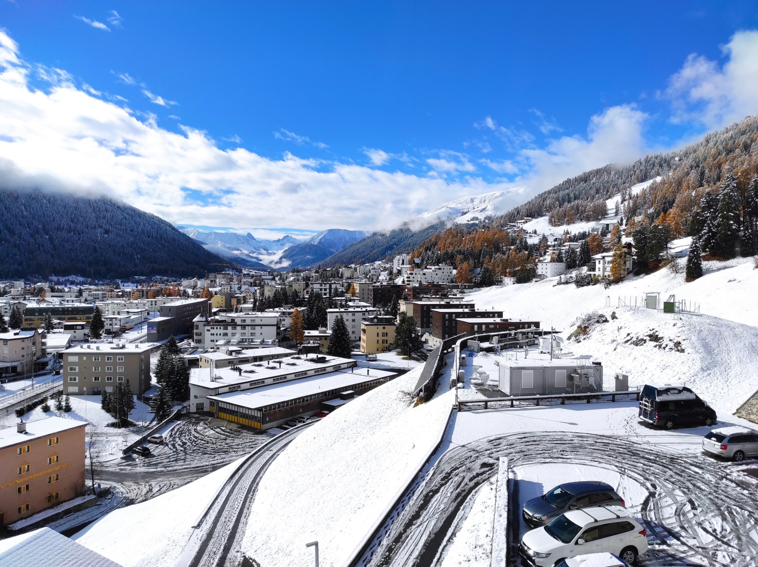
Thank you!!!
Questions???

Slide 13
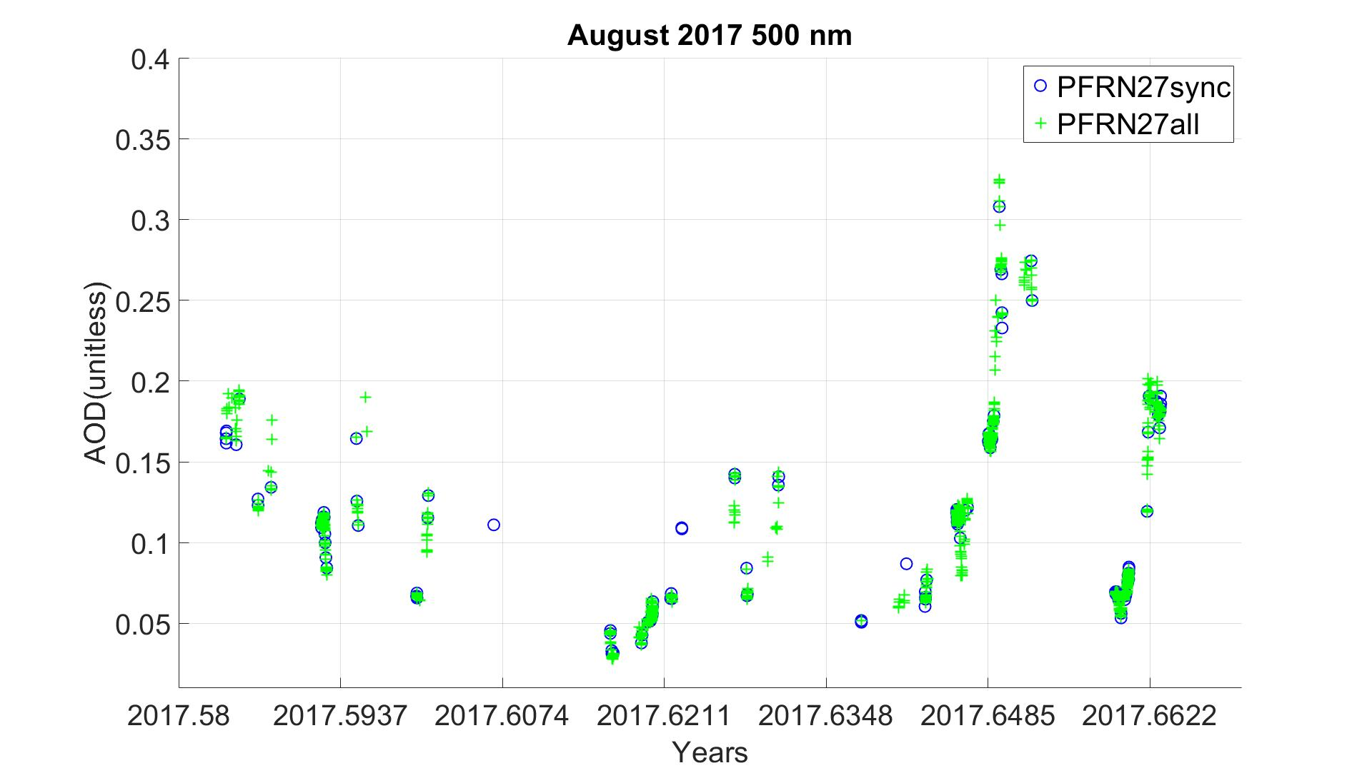
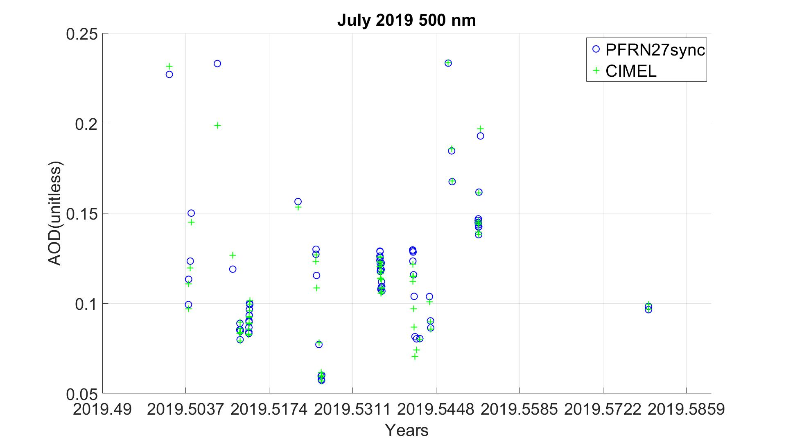
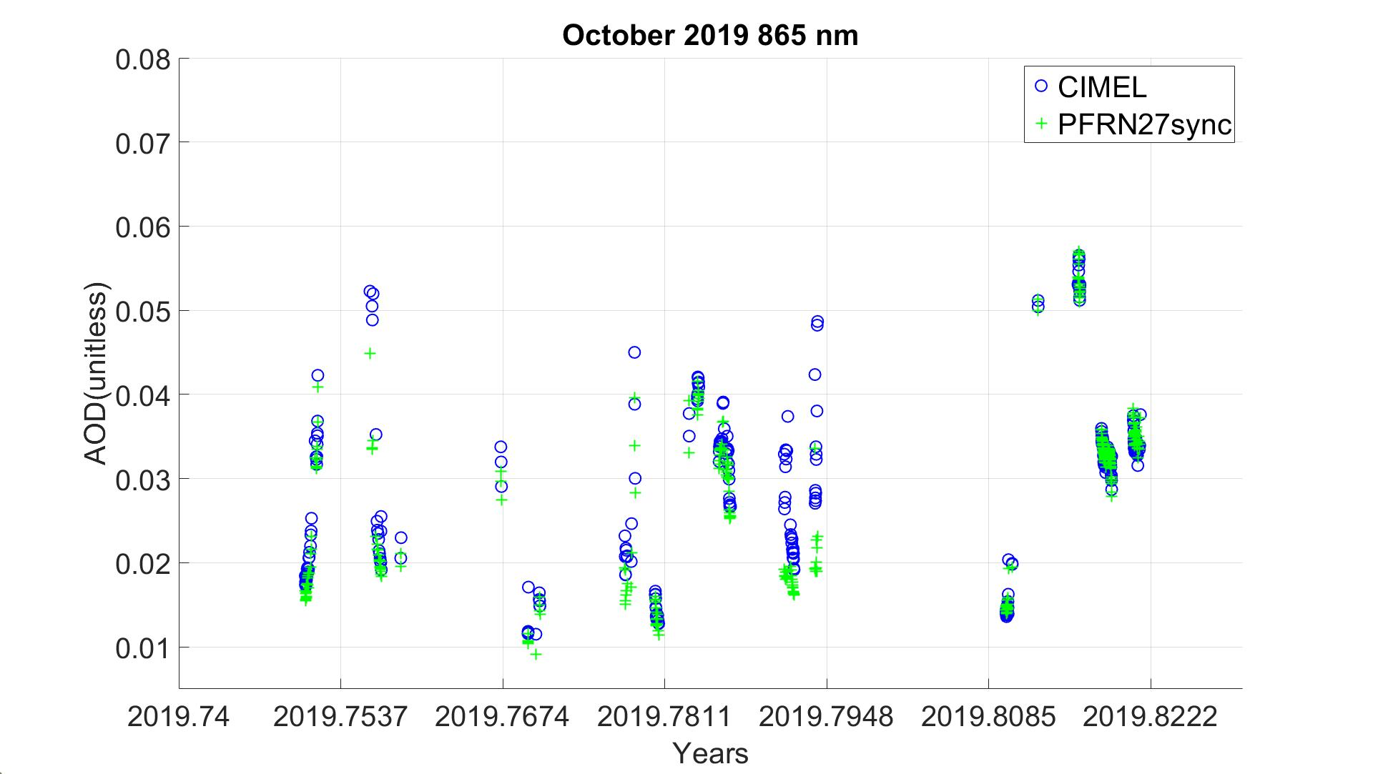
AOD difference trends | 500 nm |  | 865 nm
Timeseries | Trend per decade (10⁻³) | Standard error (10⁻³) | Trend per decade (10⁻³) | Standard error (10⁻³)
CIMEL-PFRN27 synchronous | 3.5 | 0.88 | 3 | 0.7
PFR all values-PFR synchronous | -0.88 | 0.69 | -0.039 | 0.35

